Slide 1

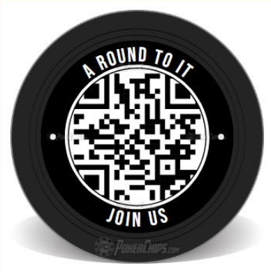
Programs &
Membership
Matt Wierzgac
State Program Director
Doug Kokot
State Membership Director

Slide 2

SOAR
An Invitation to Come SOAR with Us
Service – What Life is About
Optimism – The Faith that Leads to Achievement
Aspire – to Accomplish Great Deeds
Responsibility – to do Your Duty
Let’s SOAR to New Heights

Slide 3
Why We Recruit
  If we focus on numbers, we have already lost
  Provide an avenue for men to grow closer to God
  Grow in faith through action
  More members equal more fuel doing the good works of our order through programs

Slide 4
Supreme Quota
2634
1st Qtr 20% 2 ½ Precent Reduction
2nd Qtr 50% 2 ½ Precent Reduction
75 Star Council for Circle of Honor
Conversion – Reduction of 1 for 10

Slide 5
Expectations
Inspire Your Councils
(Use Dan Remeika’s Talking Points)
Grow the order
Lead by example - personally recruit one member by September 1st
One District Exemplification Per Month Minimum

Slide 6
Expectations (Continued)
Report your membership growth opportunities using CATs (Council Activity Tacker)
Keep the Exemplification Schedule up-to-date on the State Website
Promote Programs

Slide 7
Goals
Every Council Active by Sept 1st
Supreme Quota
20% by September 30th
No ZERO Growth Councils By Oct. 31st
Minimum of One Exemplification per Quarter per Council
Improve your councils each year

Slide 8


Slide 9
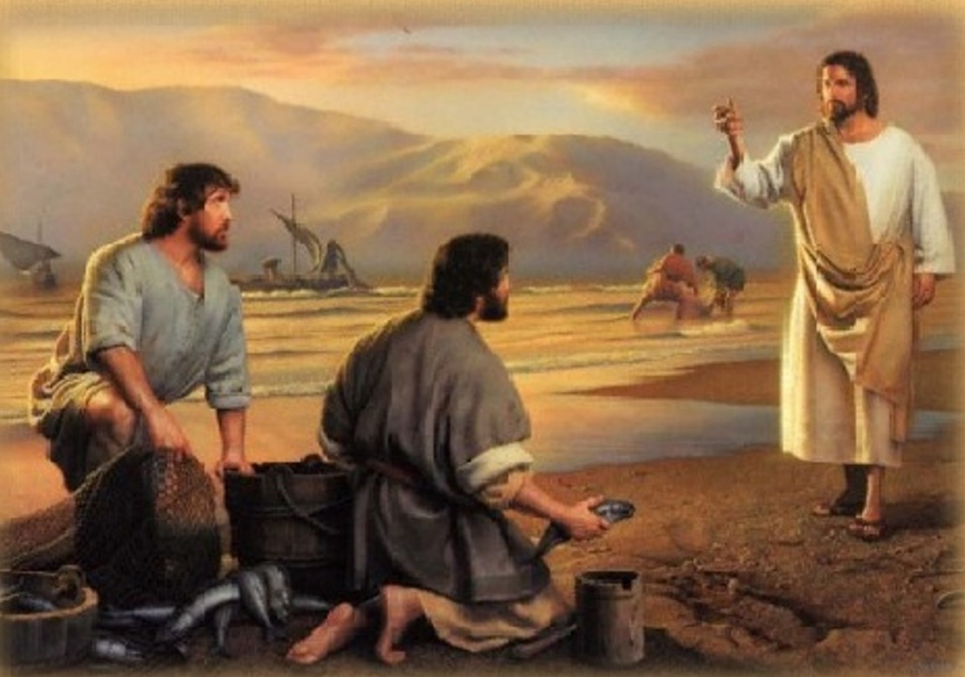

Fishers of Men
HOW TO INVITE SOMEONE
          CONVERSATION STARTERS
      OVERCOMING OBJECTIONS
      PULPIT ANNOUNCEMENTS
      EMAIL INVITATIONS SUGGESTIONS
FRATERNAL BENEFITS: WHY JOIN

Slide 10
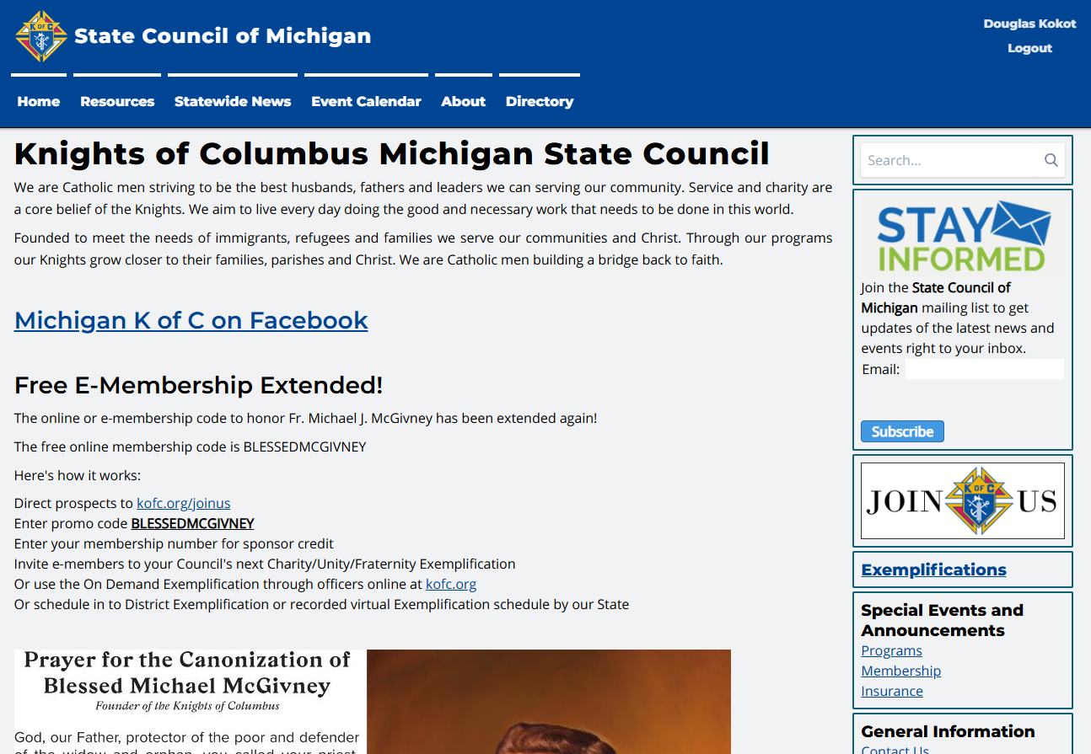
Where to Find Fishers of Men Publication

Slide 11
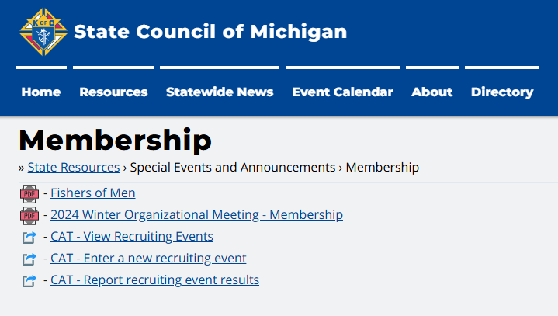
Where to Find Fishers of Men Publication

Slide 12
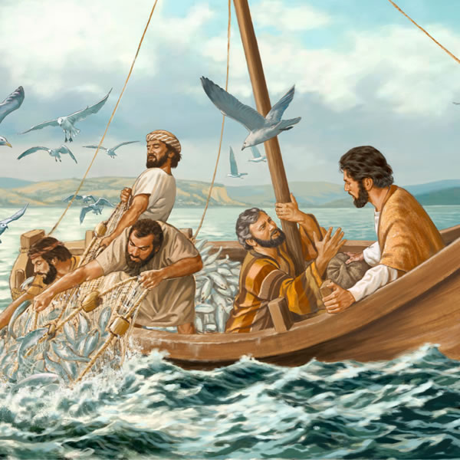
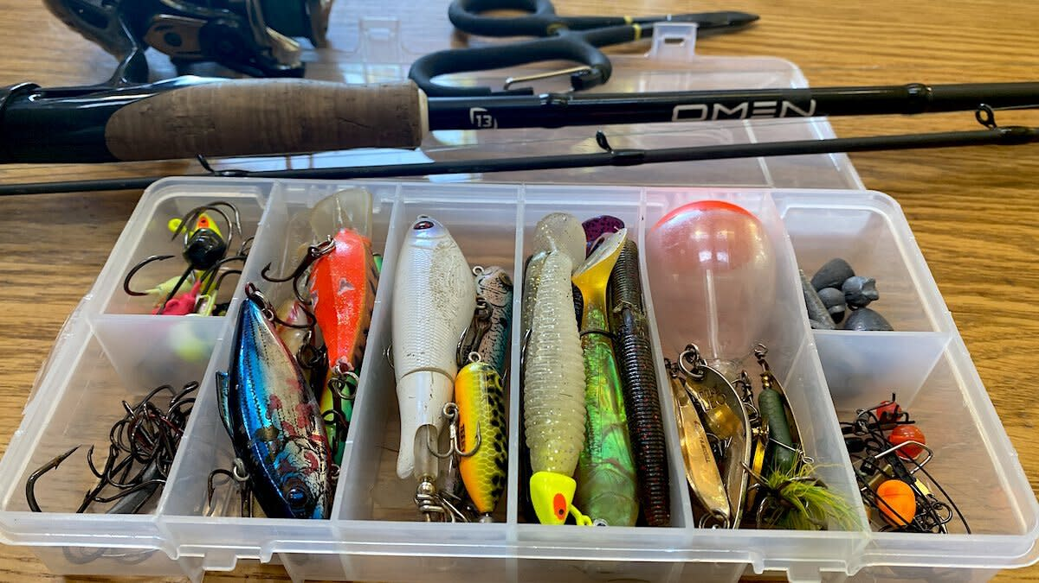
Let’s be Fishers of Men
What is in your tackle box?
Pick the right lure

Slide 13
Let’s be Fishers of Men
Every Knight is called to bring others to Christ and help realize Blessed Michael McGivney’s mission.
“Come after me, and I will make you ﬁshers of men.”
MT 4:19

Slide 14
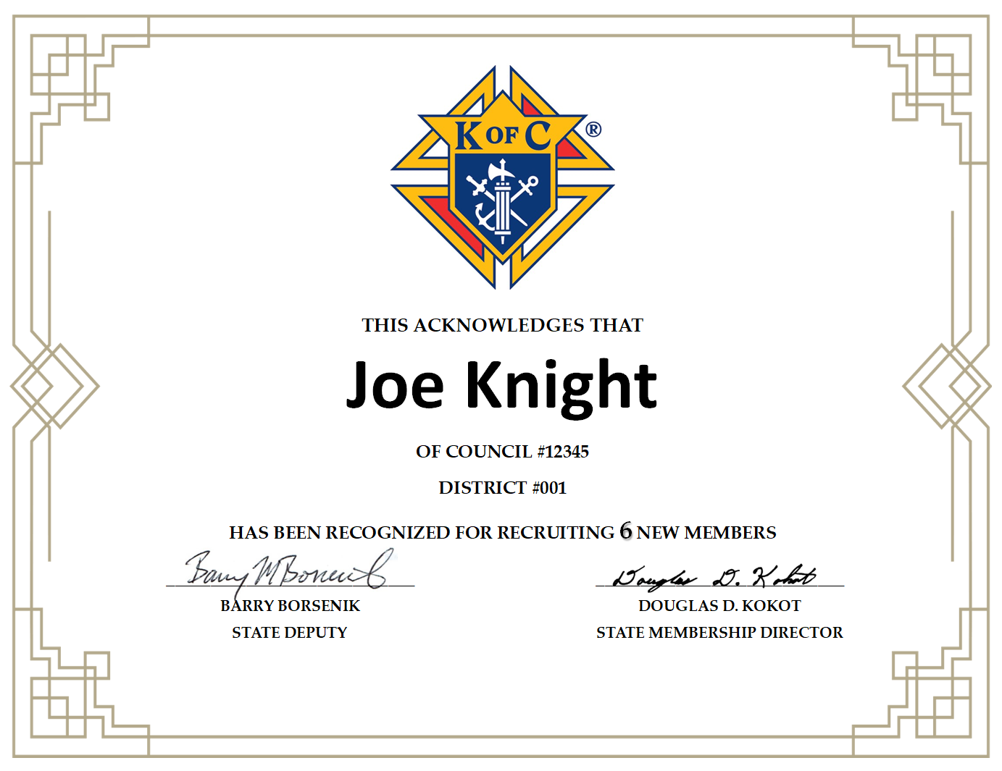
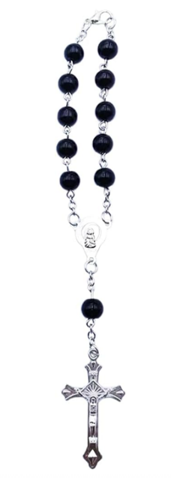
Proposers Recognition
Certificates
Car Rosary – 2 Members

Slide 15

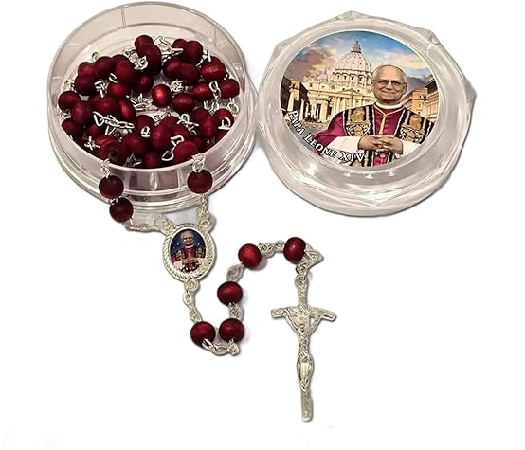
Proposers Recognition
Keychain – 4 Members
Pope Leo XIV Rosary – 6 Members

Slide 16
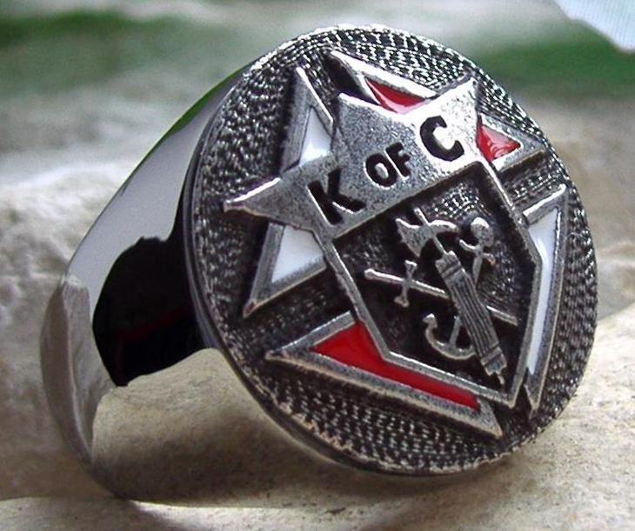
Proposers Recognition
Ring – 20 Members

Slide 17

Council Recognition
50% by September 30th
8ft Knights of Columbus Table Covering

Slide 18
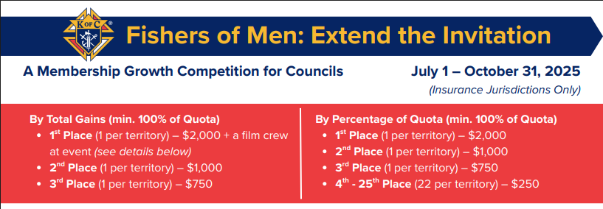
This is a Territorial competition. The jurisdictions in our territory are: Illinois, Indiana, Maine, Michigan, New Brunswick, New Hampshire, Ontario, Quebec, Vermont, Wisconsin.

Slide 19

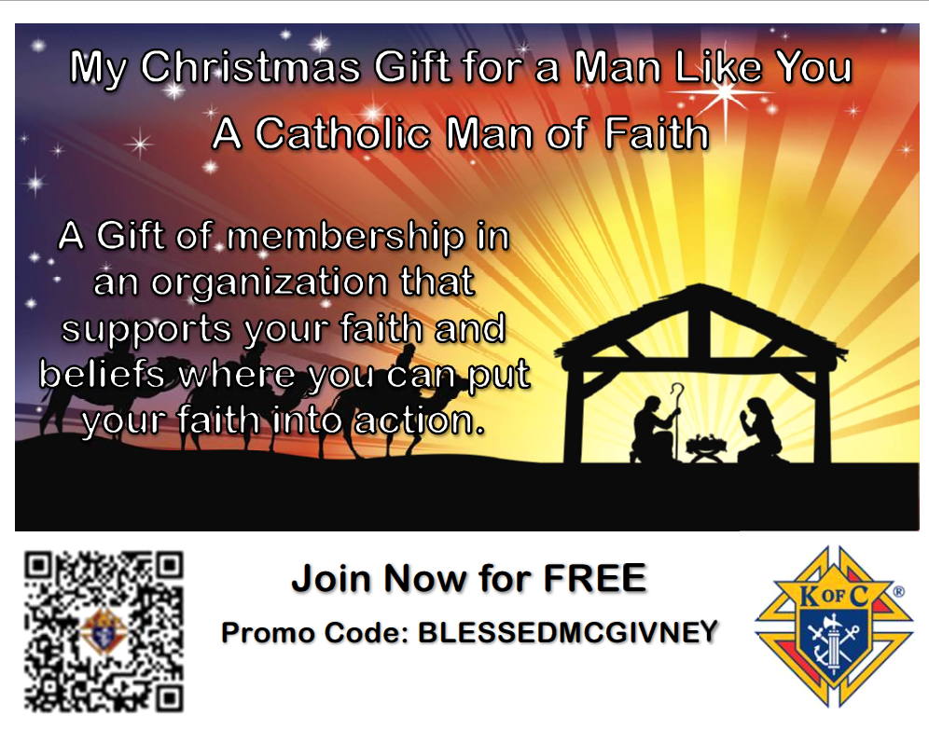
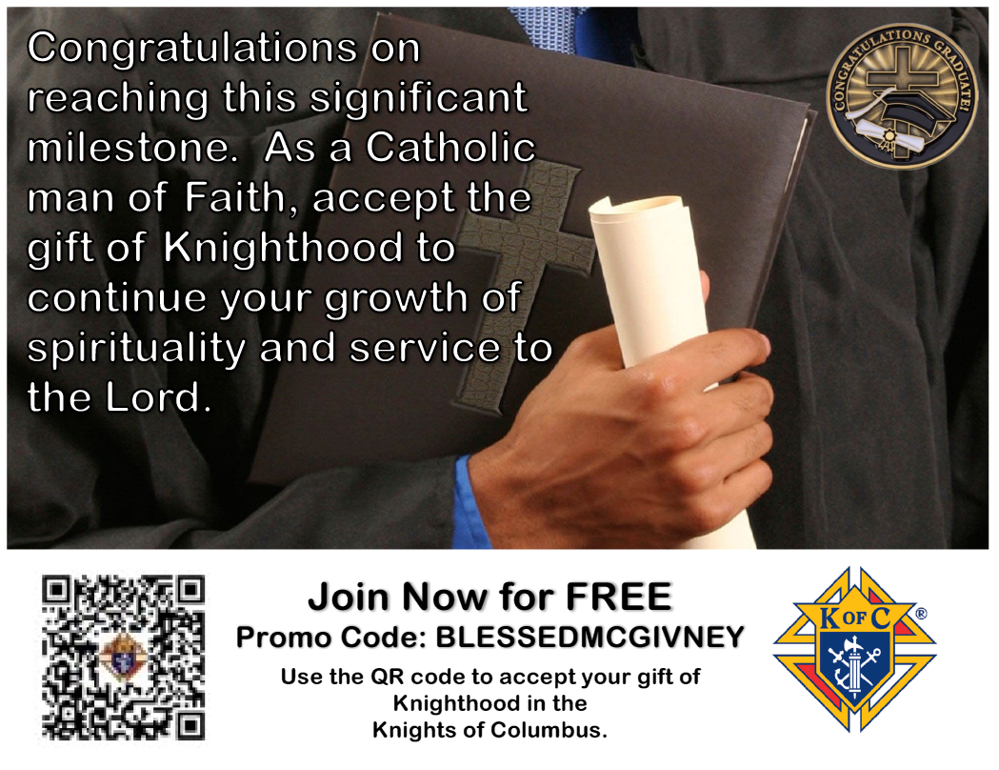

Gift Of Knighthood Cards

Slide 20
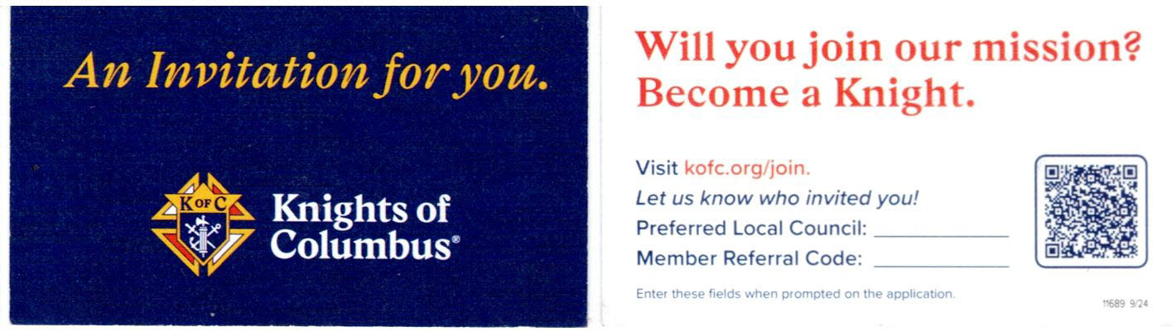
Invitation Card
11689 9/24

Slide 21
18+ Catholic Men 779,156 | Total Members 64,772
Eligible Knights 714,384 | Market Penetration 8%

Slide 22

Number One Reason Men Have Not Joined The Knights of Columbus...
They Have Not Been Asked!!!

Slide 23


Slide 24
Why We Do Programs
  Our goal is to help men; their families and their parishes grow closer to Christ. Through our programs and resources, we provide opportunities to live and spread the Catholic faith.
  Together, we’re empowering Catholic men to live our faith at home, in our parish, at work and in our community

Slide 25
First things, First…
  To begin this new fraternal year on the right foot, some items that needs to be taken care of first:
    Form 185, which is now required for Star Council & Form 365
    Grand Knight, Program Director, Family and Community Directors are 100% Youth compliant.
    Trustees ready to complete the Annual Audit (Form 1295a) and submit by 8/15

Slide 26
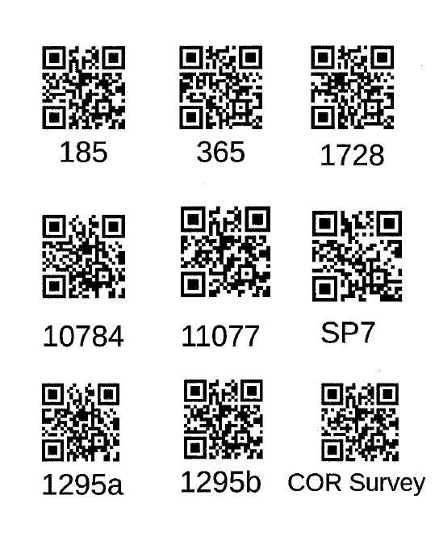
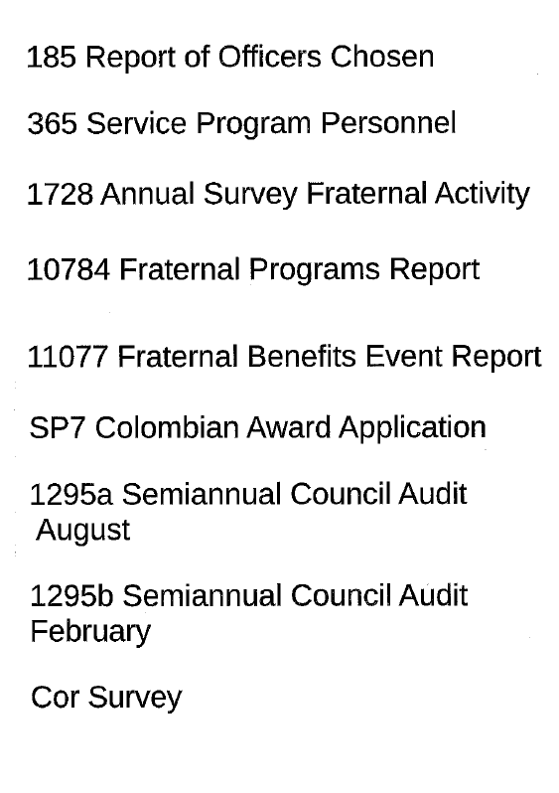
TO MAKE THINGS A LITTLE EASIER..

Slide 27
Planning for your Programs..
    Faith in Action Plan
      Council Activity Tracker (CAT)
      Parish events
      Incorporate membership growth
      Invite your District Deputy & Diocesan Directors
      Promote your programs & membership utilizing tools

Slide 28





A Review of the Faith in Action Programs
Supreme-Recommended Program Category Matrix
4
4
16
4
4
Featured Programs (Highlighted in Red) count for 2 points each.

Slide 29
NEW Featured Faith in Action Programs
Bright Futures
Celebrating our
Catholic Heritage
Viva Christo Rey
Imitating Juan Diego
Remembering our Faithful Departed
Quinceanera Support
Holy Hour for Life with
Our Lady of Guadalupe
The Gospel of Life
These can count for 2 points each if you satisfy all the requirements.

Slide 30
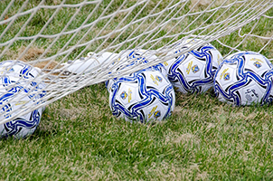
Upcoming State-Level Programs
State Soccer Challenge Finals, Saturday, October 4, 2025
Registration: 12PM, Competition: 1PM
St John Vianney Church, 4101 Clyde Park Ave SW, Wyoming, MI 49509

Slide 31

Upcoming State-Level Programs
Catholic Citizenship Essay Contest
Topic of Essay: In an essay of 500-750 words, out of the 267 popes that have led the Catholic Church, who are your three favorite popes and why?

Slide 32
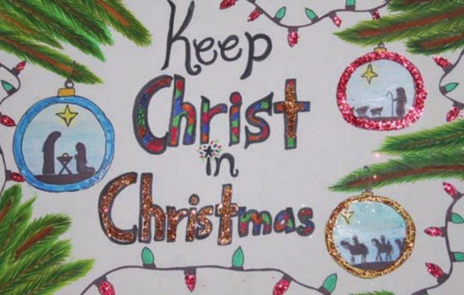
Upcoming State-Level Programs
Keep Christ in Christmas,
All submissions should be submitted to your District Deputy or Diocesan Program Director by the end of December 2025.

Slide 33
Knight of the Month / Year
GOAL: 70% of active councils
mikofc.org/resources/community-support-materials
Recognition is important
Use recognition as a recruiting tool
SEND FORMS TO: l.herman@mikofc.org & g.kolbicz@mikofc.org

Slide 34
Coats for Kids
Distribution in October/November
Fundraise at council & district now!
Ordering available Late July/ EarlyAugust 2025
Information will be given to your council

Slide 35
What Goes With Programs?
FRATERNAL PROGRAMS REPORT FORM (#10784)!
Question: Who can submit the 10784?
Answer: Anyone from your Council Roster with an active email on file.

Slide 36
What Goes With Programs?
FRATERNAL PROGRAMS REPORT FORM (#10784)!
Question: When should the 10784 be submitted?
Answer: Completion of each program, or very soon after.

Slide 37
What Goes With Programs?
FRATERNAL PROGRAMS REPORT FORM (#10784)!
Question: Where do I complete the form?
Answer: Form is done online at kofc.org website

Slide 38
What Goes With Programs?
FRATERNAL PROGRAMS REPORT FORM (#10784)!
Question: Why is the 10784 form so important?
Answer:
1. It helps give both Supreme and State an idea of what programs are being done in each of the FIA categories

Slide 39
What Goes With Programs?
FRATERNAL PROGRAMS REPORT FORM (#10784)!
2. It helps keep your council on track to meeting the requirements for the Columbian Award
3. It replaces the Form 4584, normally submitted in January, for Special Olympics.

Slide 40
What Goes With Programs?
FRATERNAL PROGRAMS REPORT FORM (#10784)!
4. The data can help with the Form 1728, submitted by January 31st.

Slide 41
What Goes With Programs?
FRATERNAL PROGRAMS REPORT FORM (#10784)!
Question: Is there training available on how to complete this form?
Answer: YES!! Training can be found on the supreme website. Search for “Fraternal Programs Report Form Training Video” in the search bar.

Slide 42
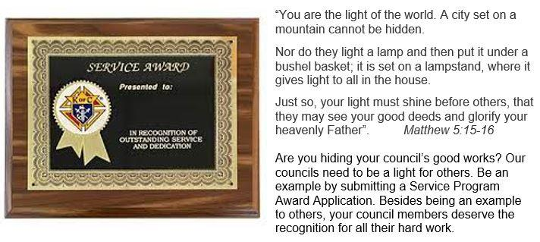
State Council Service Program
Supreme recognizes a program from each of the categories: Faith, Family, Community, and Life.

Slide 43
What is Needed to Enter?
A noteworthy program
State Service Program Award Form (#STSP)
Submit a Book
Ask your District Deputy for more information

Slide 44
To improve chances to win:
Turn in rough draft by end of November to your District Deputy or Diocesan Program Director

Slide 45

Family of the Year
Supreme recognizes a family who can best called the “model” family.

Slide 46
What is Needed to Enter?
Family of the Year Form (#10680)
Submit a Book
Ask your District Deputy for more information

Slide 47
To improve chances to win:
Turn in rough draft to the District Deputy before the Winter Leadership Meeting

Slide 48
2025 Spring Palm Sunday Drive Wrap up
154 out of the approximately 200 councils have submitted their forms and check.
Please have those checks and forms sent to Mark Brezenski, forms and checks are still being sent to George Stump and George Walrath
Both the check and form need to be submitted together.
If your council simply would like to provide a donation to the Mi drive please include a note indicating that.
REMIND YOUR COUNCILS TO GET THOSE CHECKS TO THE CHARITIES ASAP, TENS OF THOUSANDS OF DOLLARS ARE SITTING IN DRAWERS, THAT IS A BAD LOOK ON OUR PART.
More information is in the state directory under Mi Drive

Slide 49
2025 Columbus Day Weekend Drive
October 10, 11, 12, 2025
Alternate Dates:
Oct 4 - 6, and Oct.17 -19, 2025
Report & Checks Due to MI State Director by: 11/28/2025
Insurance Binder will be e-mailed to the Grand Knight, District Deputy & Financial Secretary via the Gmail mikofc.org account and posted online 30 days before the drive.

Slide 50
2025 Columbus Day Weekend Drive
Forms & Supplies:
www.MiKofC.org / Resources / Community/ MI Drive
MI-13 Intellectual Disabilities Drive Work Sheet MI-13
MI-13a Tootsie Roll Order Form MI 13a
MI-13c MI Drive Liability Insurance Cert MI 13c
Special Needs Vests (order thru your Financial Secretary)
Supplies Online/Faith in Action/Life/Special Olympics
(Traditional yellow vests are no longer available)

Slide 51
Expectations
Motivate your council members.
Aspire to do great things!
Make your council better then before!
Keep that smile on your face. Stay positive all the time.
Identify problems/resolve them
  Ask for help if needed

Slide 52

Resources
Faith In Action Manual (#10590)
Fraternal Leader Advisory on Supreme’s Website
Constant Contact
State Directory & Leadership Guide
Supreme website
State website
Dan Rameika’s Talking Points
District Deputies
Diocesan Directors
State Deputy Regional Representative’s (SDRR)
State Directors

Slide 53
Number One Reason Men Leave The Knights of Columbus...
They Have Not Been Asked!!!

